Slide 1
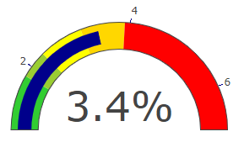

Vulnerable groups NEET
No SEND
Vulnerable group definition……
Vulnerable groups
SEND (EHCP)
SEN support

